Slide 1
What’s The Risk?
A Probability & Relative Size Activity
Notes:
TEACHER NOTES:

Slide 2
Relative Risk Lesson appropriate for middle grades, or as a warm-up for high school Relative Risk Lesson
Common Core Standards: Any standard related to fractions & multiplicative comparisons, or probability e.g. 6.RP.A.1, 7.SP.C.5 PLUS the Mathematical Practice Standards MP.2, MP.3, & MP.4 Student Objectives: To use the real-world context of risk to find and interpret relative size between two risks expressed as percentages. Teachers, this Powerpoint presentation is designed to be shared by the teacher while students use their 1-to-1 devices to log onto the Relative Risk Tool. They also need a calculator or calculator app. If you do not have 1-to-1 devices, you can still share the RR Tool on your teacher computer and have students pull the data for the class to work with. Additional follow-up questions are in the notes for each slide. Please click through “Presenter View” on your own first to read the teacher’s notes and see the animated sections pop up!
Notes:
When we implemented this lesson, we introduced it by talking to students about how COVID-19 has impacted their lives. We also kept in mind that some of the students in the class might have lost loved ones due to COVID-19 and offered an alternative assignment for those who were not comfortable discussing COVID-19. We considered multiple methods of implementation based on the teachers’ comfort in managing potentially controversial discussions. For example, students can discuss the questions in groups, but the teacher must keep in mind the potential for disagreement. An alternative is that students can work individually and then turn in their work to the teacher. The teacher can then display thoughtful and respectful responses for group discussion to promote classroom norms in discussing difficult topics.

Slide 3
Today we’re going to talk about two ideas: - Comparing riskiness - Different ways to measure comparisons
Notes:
TEACHER NOTES: Introduce the lesson.

Slide 4
Should we ever do things that have some risk? How should we decide?
Everything in life has risk, even just walking on the sidewalk!
Our job is to compare risks and not do very risky things or hurt other people.
Notes:
TEACHER NOTES: If you used the elementary lesson as a warmup, skip this slide. Slides 4-7 are meant to be used before the students get on the RR Tool website, so they aren’t distracted.

Slide 5
Is 2% percent a big or small percentage? Discuss with your partner/table. Be ready to share!
This depends on the context! A 2% tip for a waiter is small, but a 2% chance of dying is very high.
Notes:
TEACHER NOTES: Ask students to share their initial beliefs about percentages.

Slide 6
Average unvaccinated 68 year olds have a 2% risk of dying if they catch COVID-19. What does it mean to have a 2% risk?
If we keep randomly picking 68-year-olds who got COVID-19 over and over and checking on them, as we check a LOT of people we’ll find that about 2 out of every 100 died.
Notes:
TEACHER NOTES: After students discuss 1), make sure to emphasize probability not just as a “part out of whole” but a LONG-TERM pattern of how many times something does happen vs doesn’t happen (also called relative frequency).

Slide 7
Average unvaccinated 68-year-olds have 2% risk of dying from COVID-19 if infected - If I put 100 people aged 68 with COVID-19 in a room, will 2 of them definitely die? - If I put 100 people aged 68 with COVID-19 in a room, and 2 die, will everyone else definitely recover?
No, this probability is a long-term prediction for many people, not 1 set of 100 people.
Notes:
TEACHER NOTES: If some students are confused by this, offer the analogy of flipping a coin. If you flip a coin twice will you DEFINITELY get exactly one head and one tail, every time? Clearly not. But over time if you keep flipping lots of times, you will end up with about 50% heads and 50% tails. And *in general*, the more you flip the more it will steadily stay by 50%. [”In general” because the percentages *can* keep veering away from 50% for a little before coming back towards it].

Slide 8
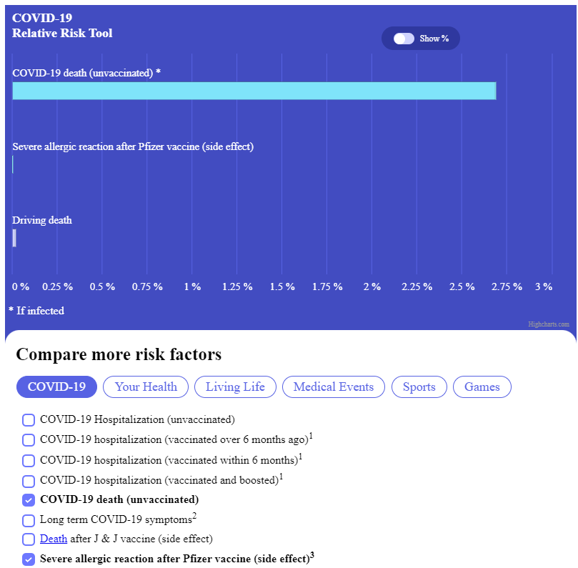
Play with the Relative Risk Tool for a few minutes!
https://www.covidtaser.com/relativerisk
Notes:
TEACHER NOTES: The website URL does not appear until after 1 click. This is so you have the option of demonstrating the RR Tool first, before they are distracted by using it themselves.

Slide 9
Use the Relative Risk Tool to answer the following questions. Be ready to share! - Pick any two ideas on the RR Tool to fill out this sentence: It is riskier to _______ than to _______. - When is driving riskier than 100 skydives?
Answers will vary for each student.
When you drive a total of 37,000 or more miles (which is about 3 years of daily driving).
Notes:
TEACHER NOTES: Give students time to work in pairs or groups to find the data to answer both questions.

Slide 10
Now let’s get more specific! Let’s not just say one activity is riskier than another. Let’s compare different activities by measuring.
Notes:
TEACHER NOTES: This section of the lesson is for practicing the two basic kinds of comparison measurements: additive (“more than”) and multiplicative (“times as much as”).

Slide 11
Practice two kinds of comparison measurements. Use a calculator! Round to 3 decimal places. 6% is _____ more than 2%. 6% is _____ times as much as 2%. 9% is ______ more than 1.75%. 9% is _____ times as much as 1.75%.
4%
3
7.25%
5.143
Notes:
TEACHER NOTES: Give students time in pairs or groups to wrestle with how to answer these questions. “more than” should be easy, but ”times as much as” is much harder for some students.

Slide 12
Okay! Let’s start comparing risks. After calculating both comparisons, work on the discussion question with your partner or group.
Notes:
TEACHER NOTES: In this section of the lesson, students will apply both kinds of comparisons measurements (“more than” and “times as much as”) to rea

Slide 13
Risk of death: 1 Everest climb is _______ more risky than 10 skydives. 1 Everest climb is _____ times as risky as 10 skydives. What does each comparison tell you?
1.596%
5.556
Notes:
TEACHER NOTES: Risks are 1.6%, .0045%. Note that the more than comparison is a percent, but the times as much comparison is not. After going over the answers to both, ask some students to share their responses to the discussion question at the bottom of each slide.

Slide 14
Chance of hospitalization* for an average 15 year old: due to COVID-19 infection is _________ more likely than from Pfizer vaccine side effects. due to COVID-19 infection is _________ times as likely as from Pfizer vaccine side effects. *Here we compare the likelihood of checking into a hospital. The average time, pain, isolation and treatment for both situations is very different. Share what these comparisons helped you understand.
.21979%
1,048
Notes:
TEACHER NOTES: Risks are 0.22%, 0.00021%. Note how the risk of Pfizer vaccine side effects is so small that the “more than” comparison is almost identical to the COVID-19 risk.

Slide 15
12+ weeks of symptoms after COVID-19 infection is ______ more likely than rolling three sixes. 12+ weeks of symptoms after COVID-19 infection is _____ times as likely as rolling three sixes. What does either or both comparison tell you?
1.837%
4.968
Notes:
TEACHER NOTES: Risks are 2.3%, .46296%.

Slide 16
Pick two risks on the Relative Risk app to compare! is _____ more risky than . is ___ times as risky as as . What did you learn from making these comparisons?
Notes:
TEACHER NOTES: Give students time to work in pairs or groups to find the data to answer all 3 questions.

Slide 17
What should Jordan’s family do? Can you use the Relative Risk Tool to help him decide?
Notes:
TEACHER NOTES: If you feel comfortable having a real-world discussion about COVID-19 in your class, then this slide and others in the high school lesson plans have many potential discussion topics. This can be used as a lesson extension.

Slide 18
What have you learned about two ways of measuring comparisons today? Which comparison did you personally feel helped you understand the data more? Did this activity change your mind about risk? Would you ever use this Relative Risk Tool to talk to others about risk?
Notes:
TEACHER NOTES: Leave the slide up for students to reflect and then share.

